Slide 1

Prospective Analysis of Stock Prices with Deep Learning
Group Presentation By
Ze Sun
Taniya
Jitendra Singh Shekhawat

Slide 2

Outline
What is Prospective Analysis of Stock Prices?
Purpose
Our Approach
Datasets & Data Preparation
Model Selection
Model Evaluation & Presentation
Limitation
Conclusion

Slide 3

What is Prospective Analysis of Stock Prices?
The prospective analysis of stock prices using deep learning is a model that will use artificial intelligence and machine learning techniques to forecast future stock prices.
It involves feeding large amounts of historical financial data into a deep learning algorithm, which then learns patterns and relationships in the data.

Slide 4

Purpose
Provide
Provide insights into market trends and predict future stock prices
Improve
Improve investment decision-making by providing more accurate predictions
Reduce
Reduce risk by providing a better understanding of market conditions
Help
Help investors make more informed decisions about when to buy and sell stocks.

Slide 5

Our Approach
A stock price may depend on several factors operating in the current world and the stock market. Over here, we will try to consider a combination of mainly two factors:
The past performances and records of the target company
The impact and correlation of stock prices of other companies i.e., how the increase and decrease of stock prices of the other companies affect the stock price of a given target company

Slide 6

Datasets
We are first scrapping list of tickers of S&P 500 companies.
Then we are collecting daily stock details of 200 companies from Yahoo Finance.

Slide 7
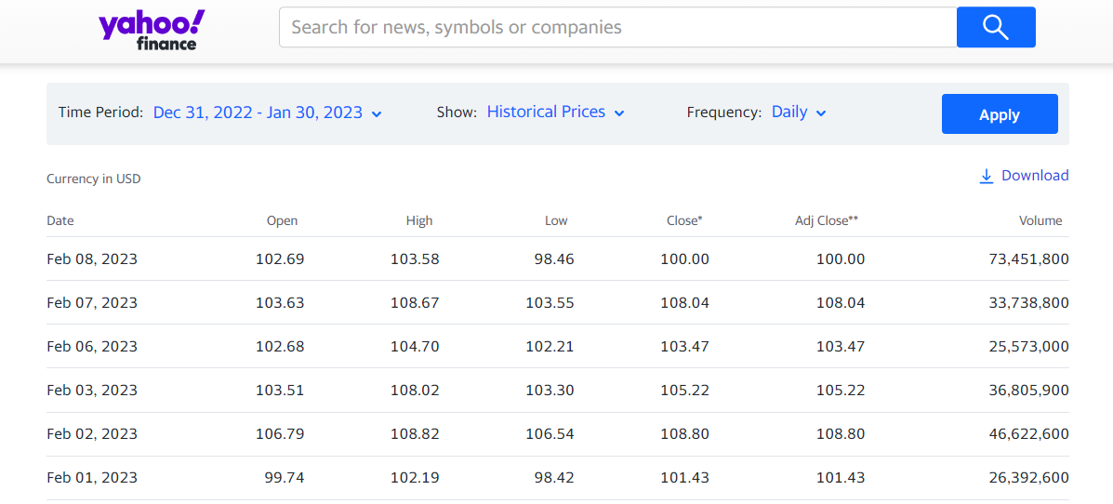
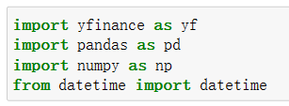
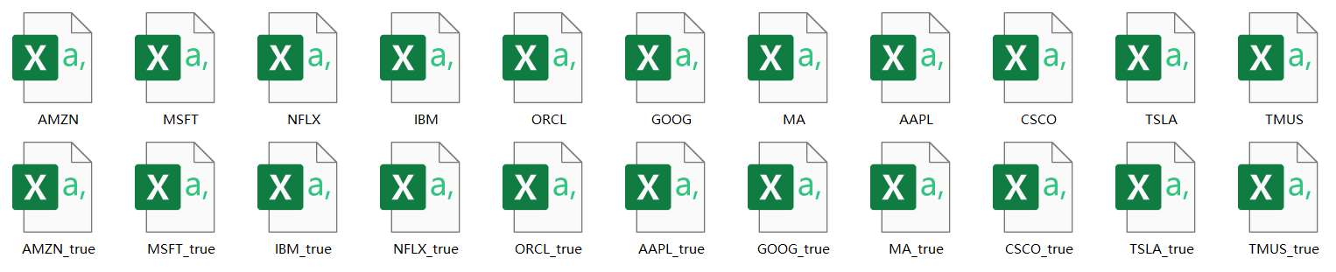
Access the Data
Yahoo Finance API
Data

Slide 8

Data Preparation
Perform necessary preprocessing based on model requirement
Selection of Feature and Target columns
Converting data into the correct format or shape
Normalizing or Standardizing the Data

Slide 9

Model Selection
A neural network-based Regressor model which considers the impact of other companies on the target company.
A Recurrent Neural Network Model to study the past behavior of the target company and give results accordingly.
An Artificial Neural Networks which takes in both their predictions and helps reach a firm and robust conclusion.

Slide 10
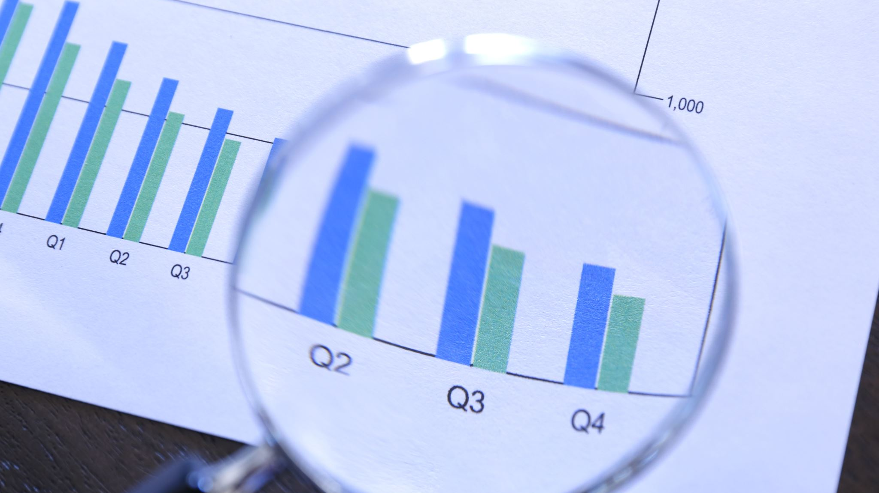
Model Evaluation
Model evaluation is a crucial step as it involves evaluating the performance of the predictive model to determine how well it can forecast future stock prices.
There are many metrics that can be used to evaluate the performance of a deep learning model for stock prediction and the choice of metrics will depend on the specific goals of the prediction task and the requirements of the stakeholders.

Slide 11

Tableau Dashboard
The output of the predictive model, such as predicted stock prices, will be displayed in a variety of formats, including tables and charts on the dashboard.
We will add Interactive filters to the dashboard to allow users to select specific stocks, time periods, and other variables to view.
This Photo by Unknown Author is licensed under CC BY

Slide 12
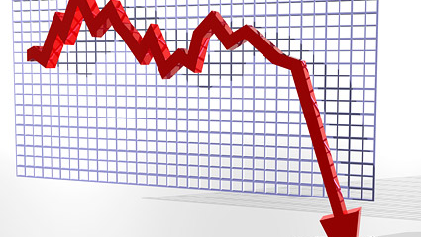
Limitation
Fundamental factors such as a company’s intrinsic value, assets, quarterly performance, recent investments, and strategies all affect the traders’ trust in the company and thus the price of its stock.
Only a few of the latter can be incorporated effectively into a mathematical model.
Moreover, it is nearly impossible to anticipate a piece of news that will shatter or boost the stock market in the coming weeks – a pandemic or a war.

Slide 13

Conclusion
Our project aims to contribute to the advancement of stock price prediction by utilizing deep learning techniques.
The models developed in this project will have the potential to provide valuable insights to investors and traders, helping them make informed decisions in the stock market.

Slide 14

References
https://medium.com/@mrconnor/an-automated-stock-trading-system-using-deep-learning-63803914cead
https://towardsdatascience.com/predicting-stock-prices-using-a-keras-lstm-model-4225457f0233
https://www.analyticsvidhya.com/blog/2021/12/stock-price-prediction-using-lstm/

Slide 15

Thank You

